Slide 1
FINAL REVIEW-22.09.2020

Slide 2


SALEM COLLEGE OF ENGINEERING AND TECHNOLOGY
RURAL HEALTHCARE MONITORING SYSTEM THROUGH WIRELESS COMMUNICATION USING CLOUD COMPUTING TECHNOLOGY WITH MACHINE LEARNING PLATFORM
GUIDED BY, PRESENTED BY,
MS. M. SIVABARATHI, M.Tech., K. Bapitha (622416121003)
Asst. Professor, R. Hemavathi (622416121008)
Department of Biomedical Engineering M. Prithivi (622416121026)
N. Roshan Safeeha (622416121032)

Slide 3
OBJECTIVE
To provide healthcare to the rural area people and bring awareness by using machine learning platform.
VISION
To enrich the living hood and standardized life in the rural region.
MISSION
To create awareness and measure the various health parameters of the rural area peoples by using five different sensors.

Slide 4
THE PROBLEM ADDRESSED
Due to lack of awareness and lack of education in rural areas, people those who are living here are facing many health issues in daily life.
By implementing this technology, we monitor the five health parameters of the patients.
Mainly this technique is used for the maintenance of the healthcare of the patients and for the earlier detection of the diseases.
In the existing system they have used Raspberry pi which was high cost so that we have used the Arduino Uno which is low cost.

Slide 5
METHODOLOGY / TOOLS USED
In wireless communication, radio waves are used to transfer the bio signals from rural areas into the cloud server for analyzing the patient parameters .
Cloud computing is the on-demand availability of computer system resources, especially data storage and computing power, without direct active management by the user.
Machine learning focuses on the development of computer programs that can access data and use it learn for themselves.
TOOLS
Heartbeat sensor
Pressure sensor
Temperature sensor
Oxygen sensor
Accelerometer sensor

Slide 6
COMPANY HISTORY
Company Name: BIOPLUS MEDICAL SYSTEMS, Trichy.
The company was started at 2014.
Bioplus is a leading distributing and service providing company for biomedical instrumentation and for diagnostic and therapeutic equipment's.
Products distributed by the BIOPLUS MEDICAL SYSTEMS:
Auto hematology analyzer.
Heart rate monitor.
Blood test monitor.
Blood bank centrifuges.

Slide 7
BIOPLUS MEDICAL SYSTEMS
NO OF EMPLOYEES WORKING:
8 Employees are working in Bioplus medical systems.
CUSTOMER TO COMPANY:
Healthcare sector, Medical equipment manufacturers, Medical and paramedical institutions.
COMPETITORS OF THE COMPANY:
1. SRI VIGNESH MEDI EQUIPMENT,TRICHY.
2. LOGIC BIO MEDICAL TECHNOLOGIES,TRICHY.
3. UNIVERSAL DIAGNOSTICS, TRICHY.
4. SRI RANGA SURGICALS, TRICHY.

Slide 8
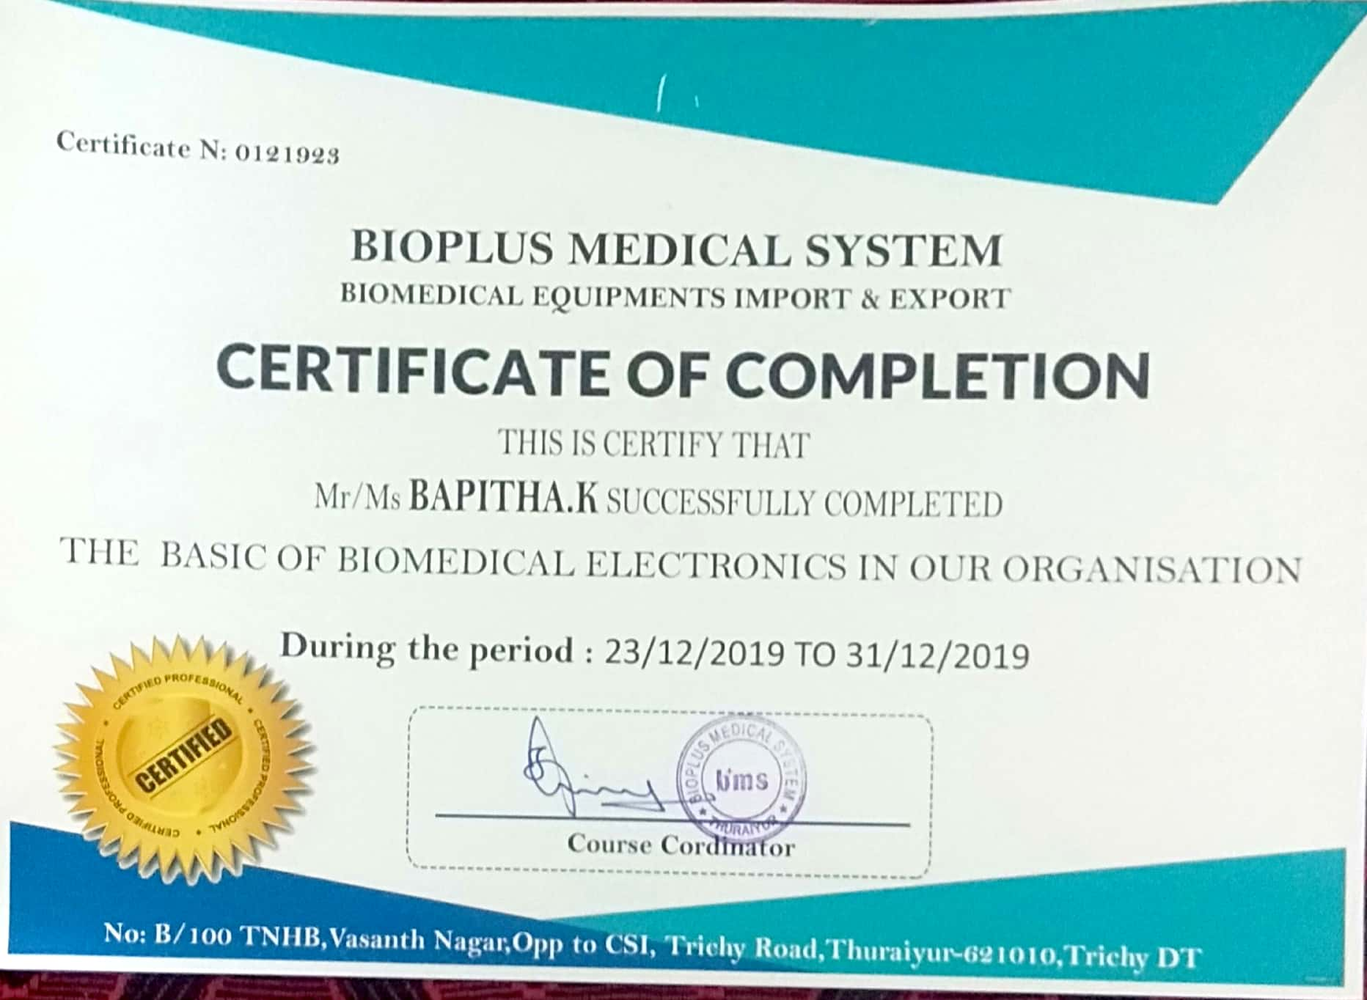
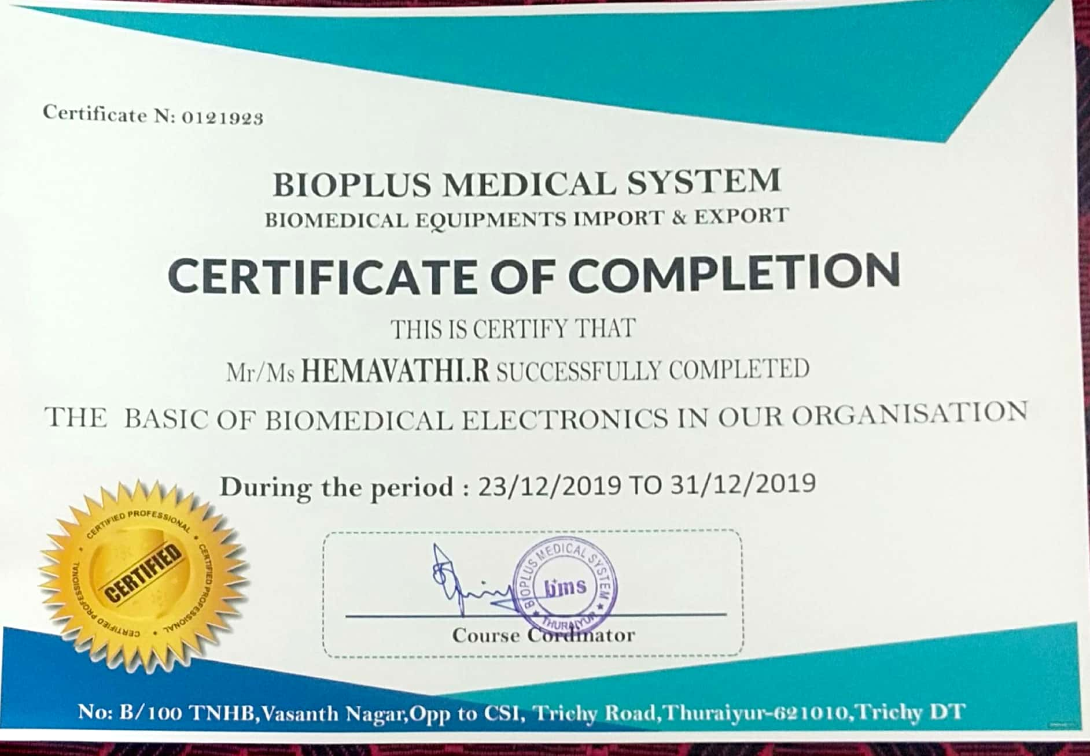
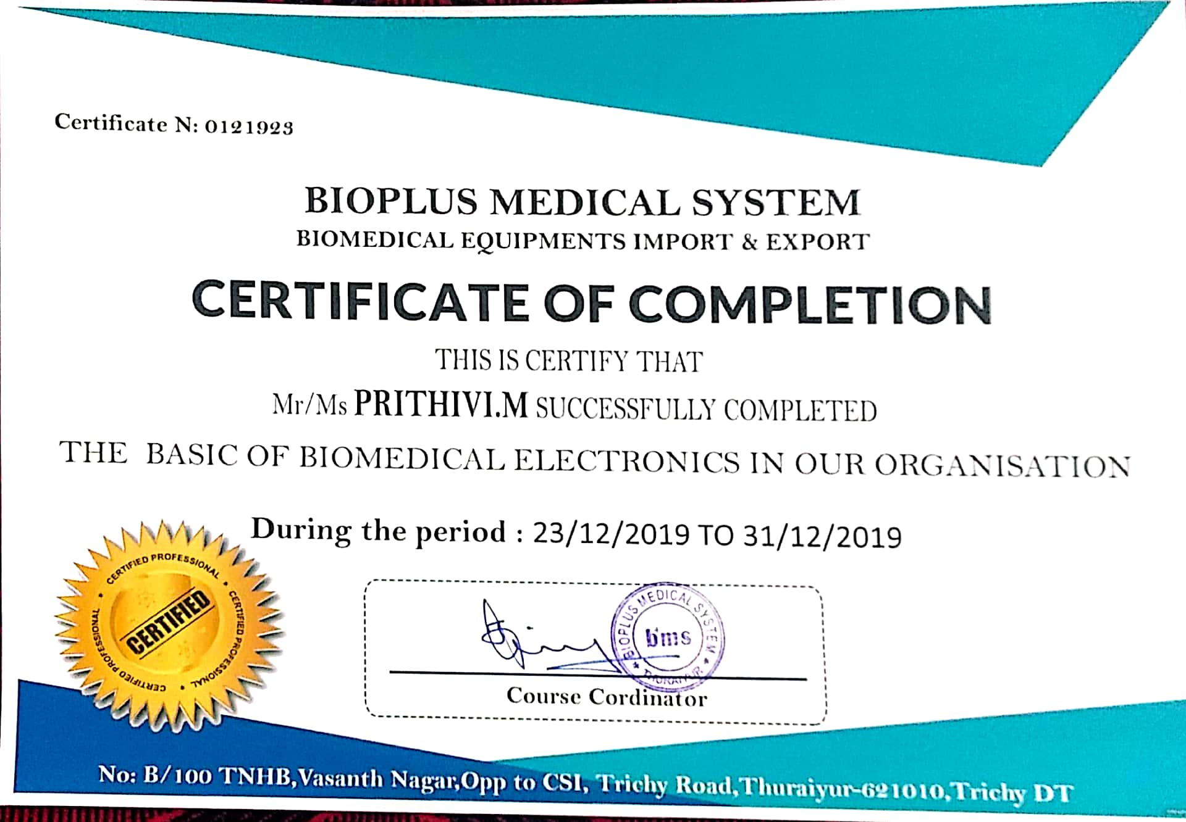
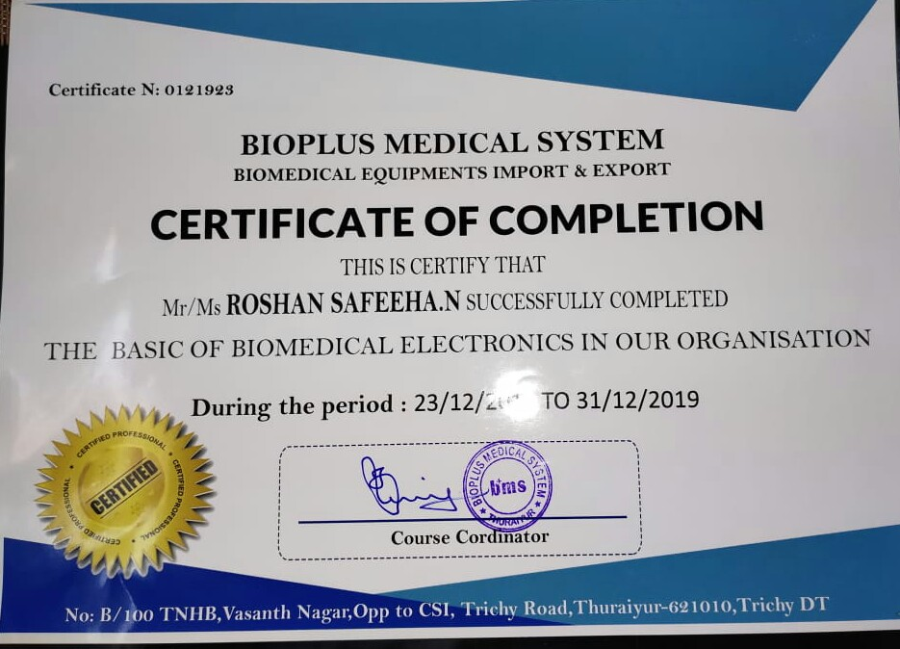
INTERNSHIP CERTIFICATE

Slide 9
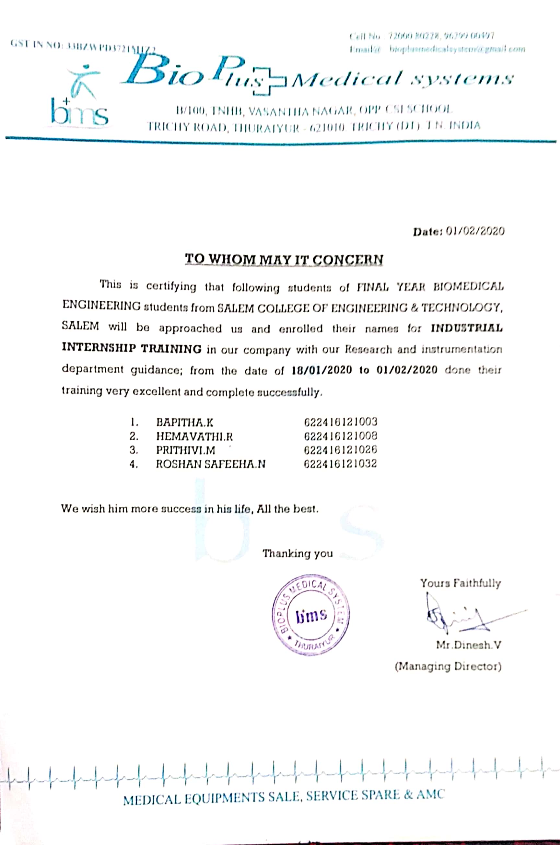
INTERNSHIP CERTIFICATE

Slide 10
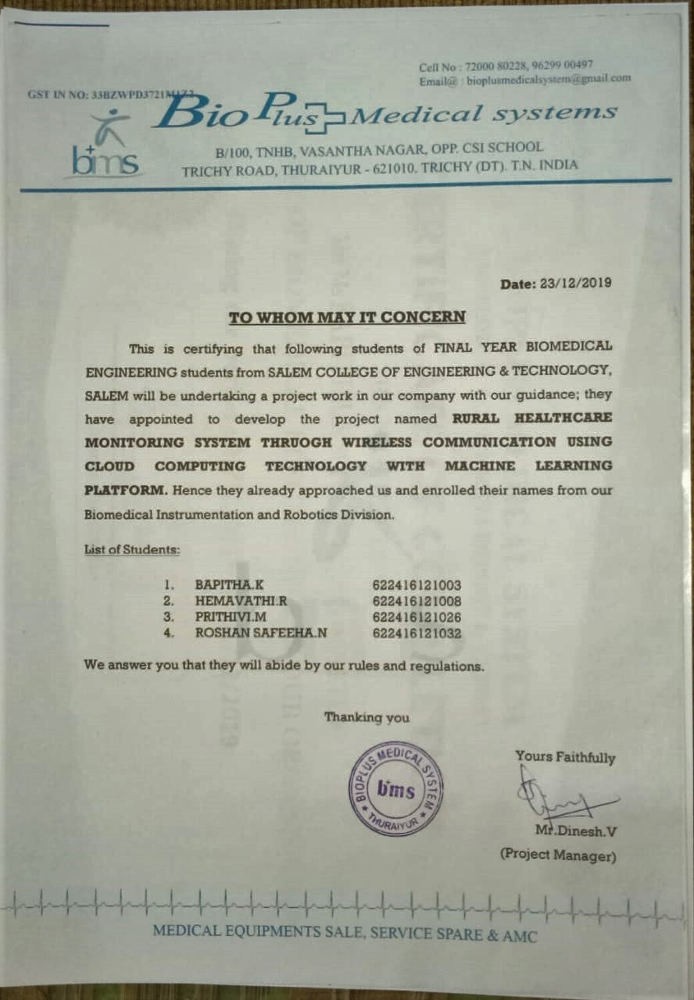
ACCEPTANCE LETTER

Slide 11
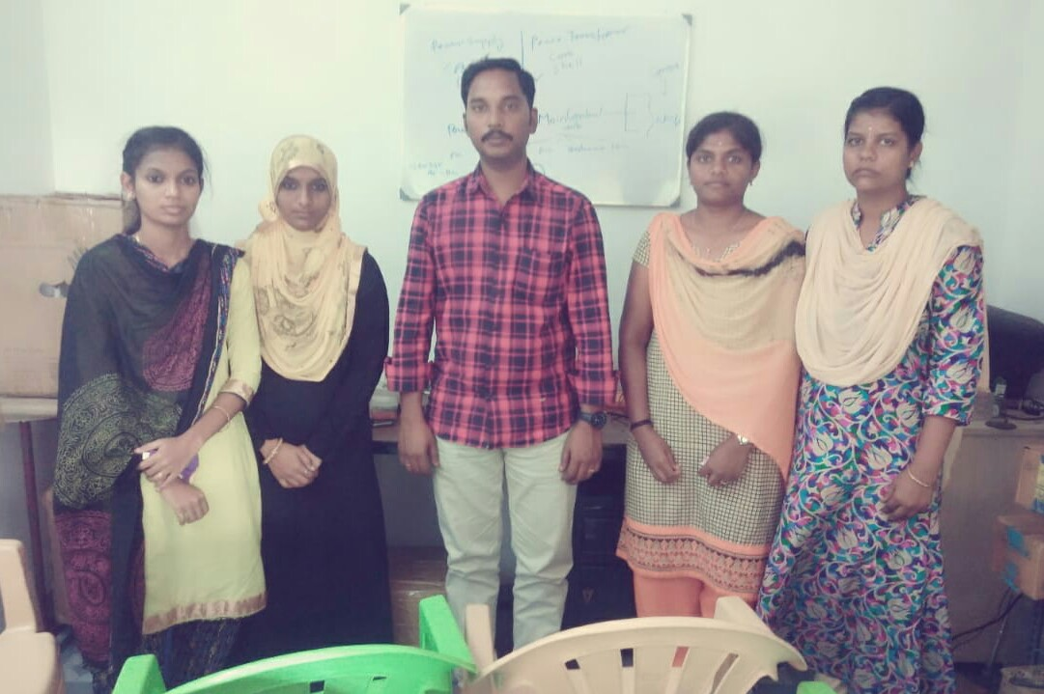
AT BIOPLUS MEDICAL SYSTEMS

Slide 12
EXISTING SYSTEM
Zigbee protocol was used only for transmitting of the bio signals from one area to the another which can be further analyzed by the physicians.
So it can store only small amount of the patient data’s.
In this system, we can measure the data.
fig. 1 Block diagram of Existing system

Slide 13
PROPOSED SYSTEM
Arduino Uno is a device which is used to collect the information from the sensors and then the data’s are stored in web server with the help of cloud computing technology.
Patient information can access world wide by using cloud computing through the machine learning platform.
We implement this technique mainly in rural areas for the maintenance of their healthcare.
Fig. 2 Block diagram of Proposed system

Slide 14
DIFFERENCE BETWEEN EXISTING AND PROPOSED SYSTEM
Table 1. Difference between Existing and Proposed system
EXISTING SYSTEM | PROPOSED SYSTEM
In this existing system zigbee technology was implemented. | Used advanced technique (cloud computing technology ).
Small amount of data’s can be stored. | Large amount of data’s can be stored in web sever.
Five parameters are monitored and signals are transferred by using raspberry pi. | Signals are transferred by using Arduino Uno.
Patient data access with in a particular place. | Patient data access any where in the world.

Slide 15
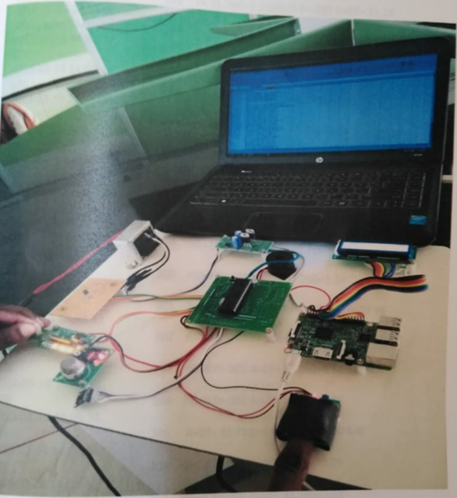
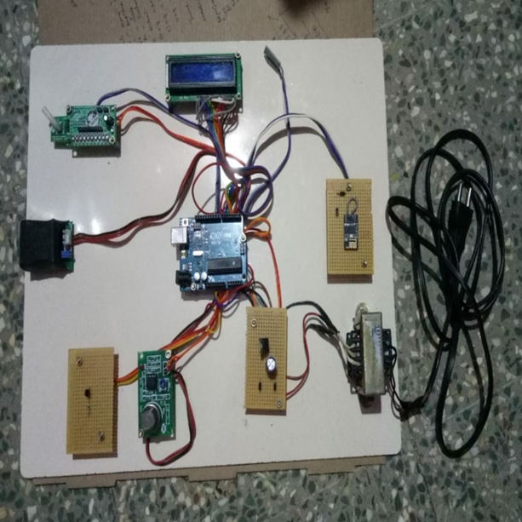
DIFFERENCE BETWEEN EXISTING AND PROPOSED SYSTEM
EXISTING SYSTEM
PROPOSED SYSTEM
1
2
3
4
5
6
7
8
9
10
Fig. 3 Prototype
Fig. 4 Implementation

Slide 16
COMPONENTS
Accelerometer sensor
LCD (Liquid Crystal Display)
Pressure sensor
Heartbeat sensor
IOT (Internet Of Things).
Arduino Uno
Transformer
Regulated power supply
Oxygen sensor
Temperature sensor

Slide 17
PROJECT DETAILS
Our native places are located at rural areas where people suffered from various health illness.
Due to the lack of health awareness and lack of education our people are facing many health issues in daily life.
To enhance the income of that people we implemented one prototype which monitors the health parameters like heart rate, blood pressure, oxygen saturation level, temperature and fall detection.
Sensors are used for acquiring the bio-signals from the patient bodies.
The acquired signals are processed and controlled by Arduino Uno.
The processed signals are stored in the specified cloud server with privacy.
The stored signals are retrieved by the patient close relatives and family physicians present anywhere in the world by using laptop or smart phone with internet.

Slide 18
Machine learning language is used to write the program.
Here module acts like telemedicine in future which can be implemented at rural areas to help and prevent the people suffering from diseases.

Slide 19
RESULTS AND DISCUSSION
The rural health care monitoring system through wireless communication using cloud computing technology with machine learning platform is done for monitoring the five parameters that are Heart rate, Blood pressure, Temperature, Oxygen and Body movements.
To create awareness for rural people about education and healthcare.
To overcomes the previous system by monitoring the health parameter’s sending and store in web server by using cloud computing technology.

Slide 20
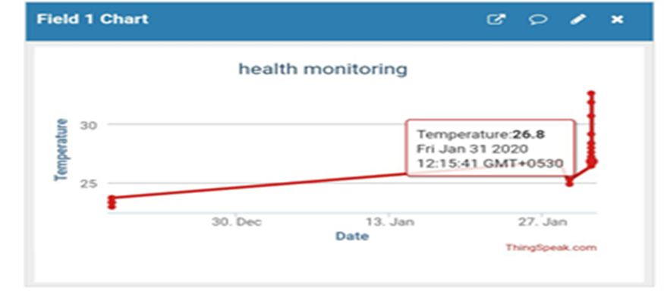
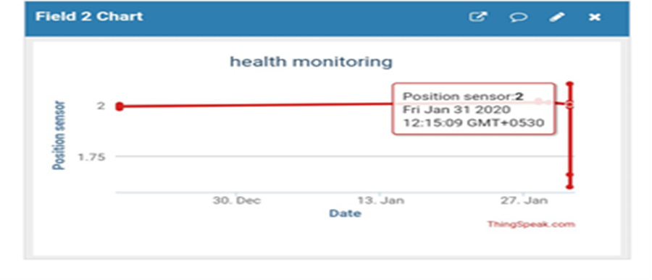
OUTPUT
Fig. 5 Field 1 Chart of Temperature
Fig. 6 Field 2 Chart of Position sensor

Slide 21
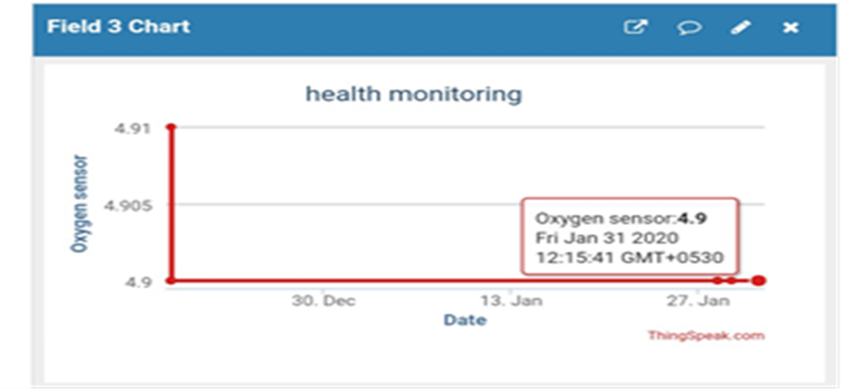
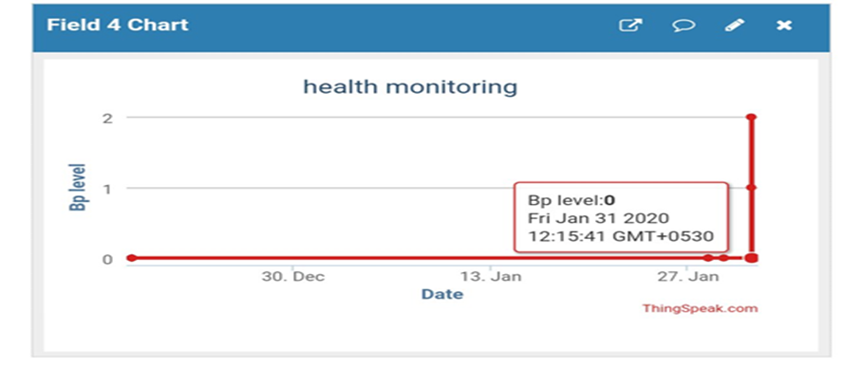
Fig. 7 Field 3 Chart of Oxygen sensor
Fig. 8 Field 4 Chart of BP level

Slide 22
CONCLUSION
The development of this technology is useful for the rural area peoples which changes their lifestyle into a new level.
Patient have an any abnormalities in the health conditions can be known directly and are informed to the particular person through via internet.
The objective of developing monitoring systems is to reduce health care costs by reducing physician office visits, hospitalizations, and diagnostic testing procedure.

Slide 23
FUTURE ENHANCEMENT
Mainly focused on of rural healthcare monitoring system through wireless communication using cloud computing technology with machine learning platform which could be utilized for the ease of monitoring health parameters in telemedicine sector.
The future work of the system is to make a single module like a wearable gloves is testing of the speed of the sensor to measure and sending data’s to web server.

Slide 24
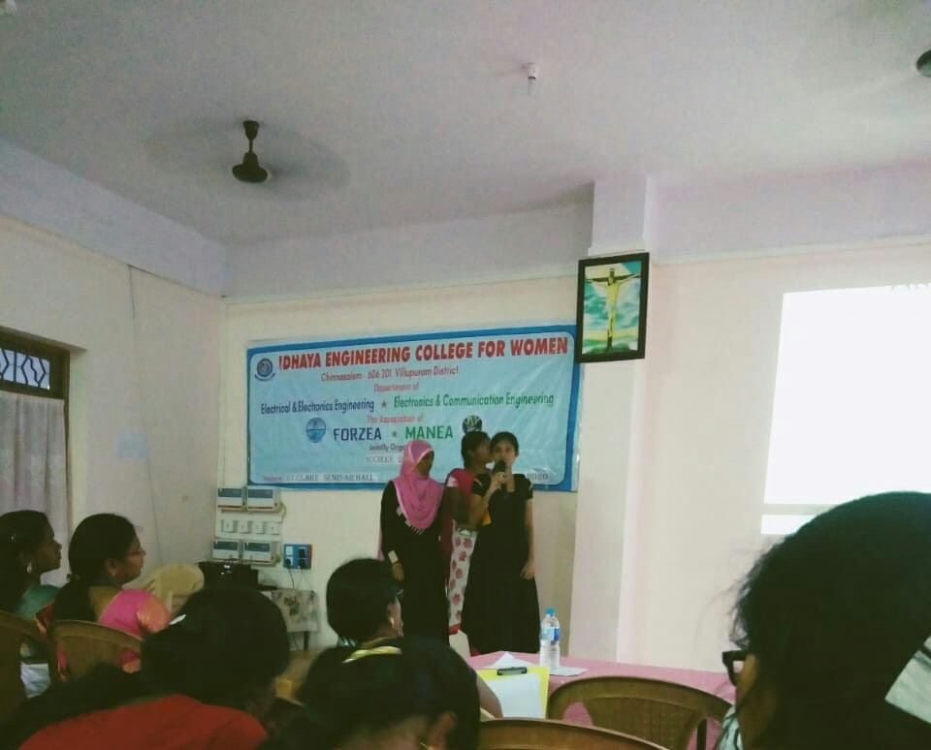
AT CONFERENCE

Slide 25
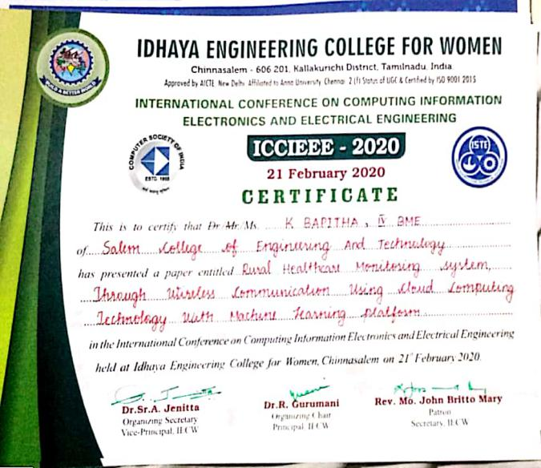
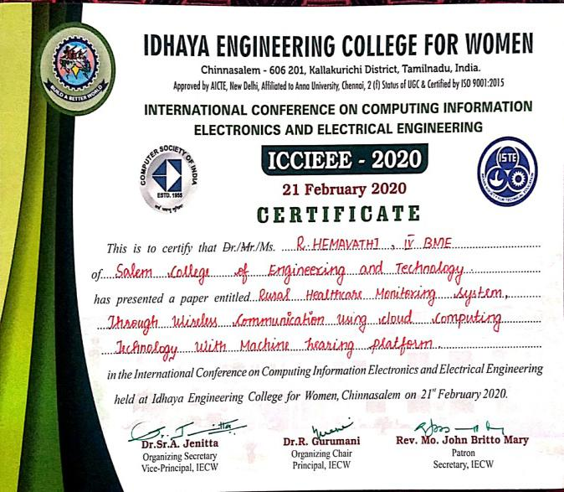
CONFERENCE DETAILS
Our project entitled “Rural healthcare monitoring system through wireless communication
using cloud computing technology with machine learning platform” was present the Fourth
International Conference on Computing Information Electronics and Electrical Engineering
(ICCIEEE-2020) on 21 February at Idhaya Engineering College for Women, Chinnasalem,
Tamilnadu, India.

Slide 26
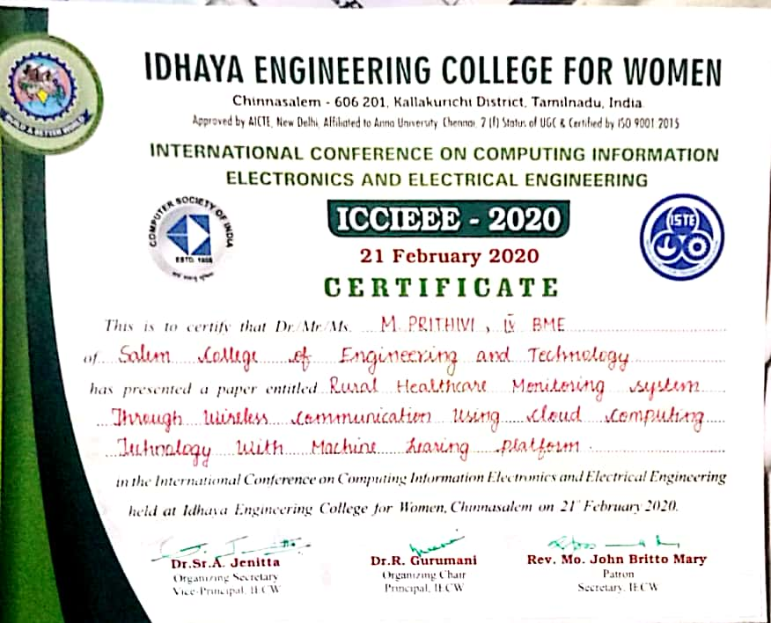
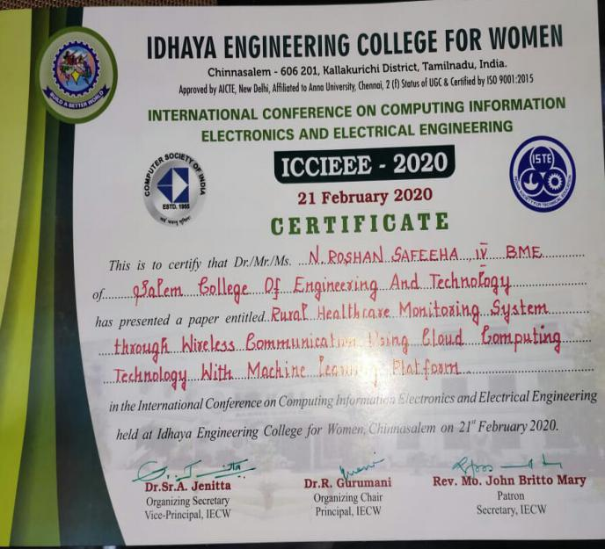

Slide 27
THANK YOU…

